Slide 1
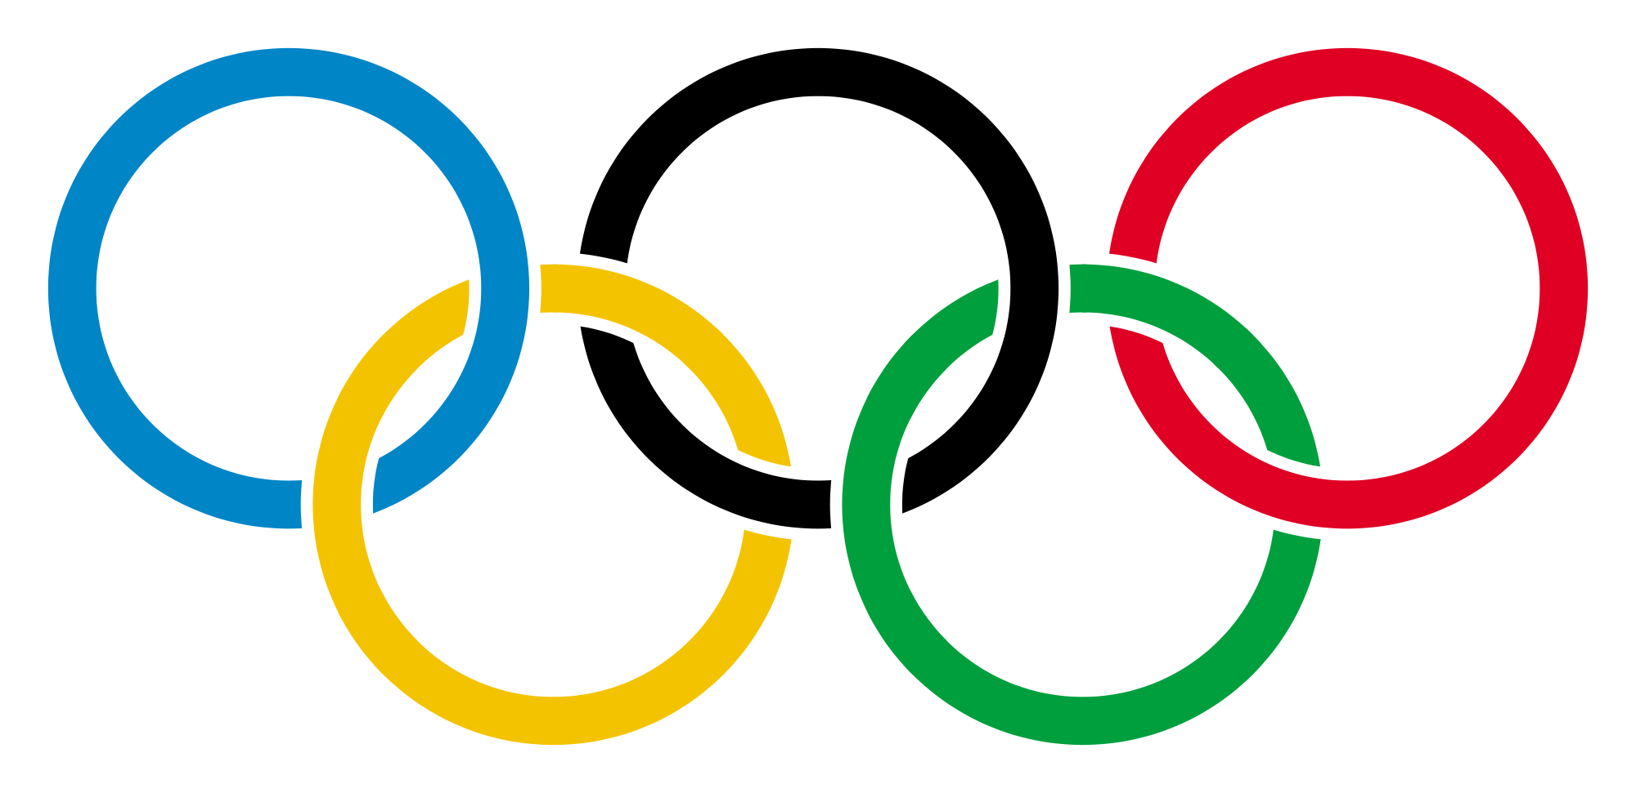
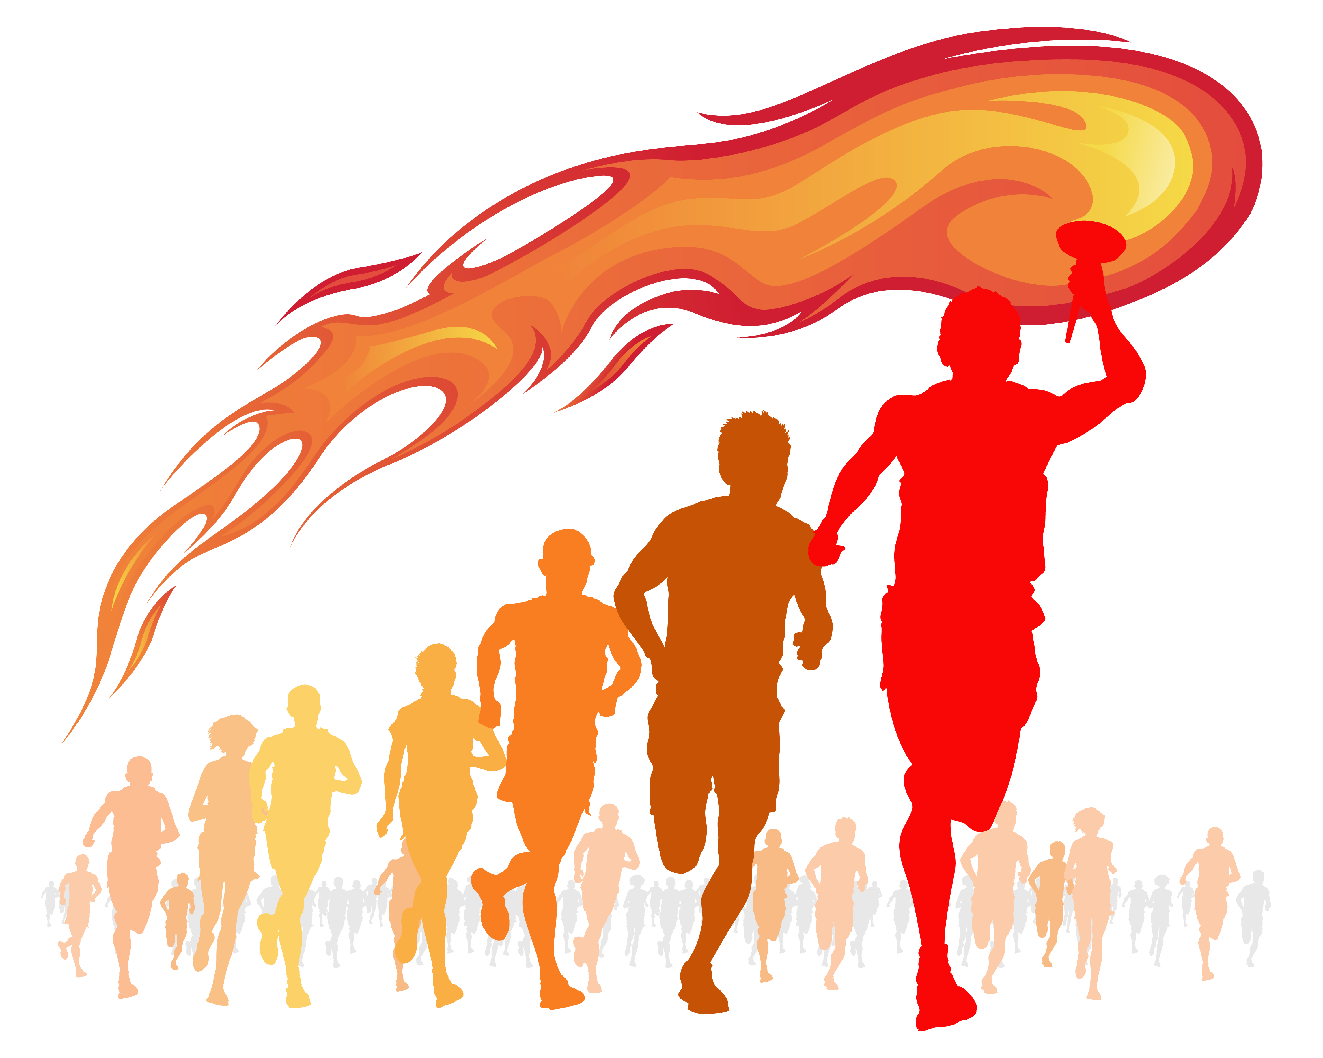
Citus, Altius, Fortius: Does Height Matter in the Olympics?
Jeremy Sabio, Kasie Wong, Michael Dowlin
November 2019

Slide 2

Inspiration
The first modern Olympic games took place in 1896 (1).
In the last 60 years, the number of world records broken at the Olympics has exponentially increased (2).
Globally, the average male height has increased since 1896 with improvements in nutrition and standard of living across the world (3).
Men have gotten taller over time. Is this trend observed in average Olympian height over time?

Slide 3


Source Data
120 Years of Olympic History: Athletes and Results
From Athens 1896 to Rio 2016
Evolution of Adult Male Height Over Time

Slide 4
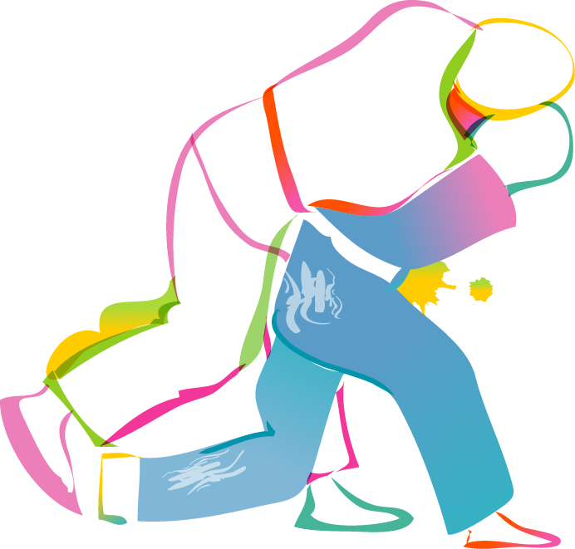
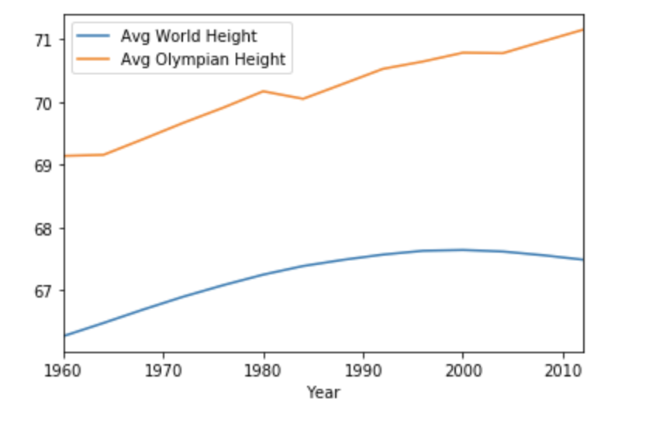
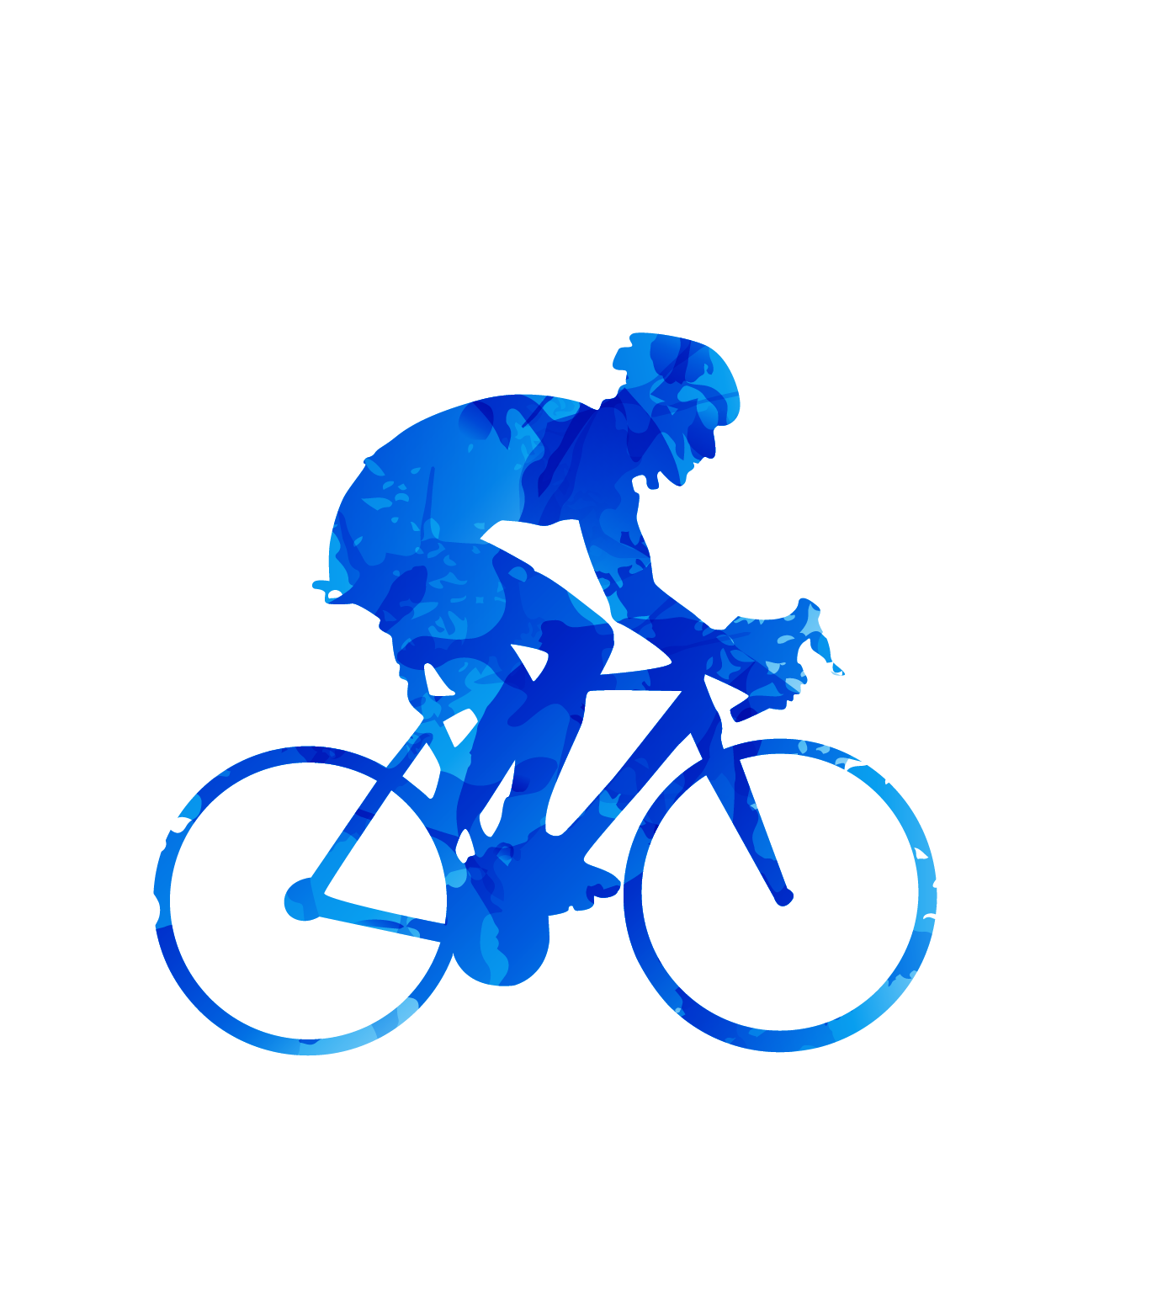
Compare Average Heights of Olympians vs Non-Olympians in Year 1896-2016

Slide 5

Athlete Average Age Per Olympiad Over Time

Slide 6

How much Olympic height data is there?

Slide 7
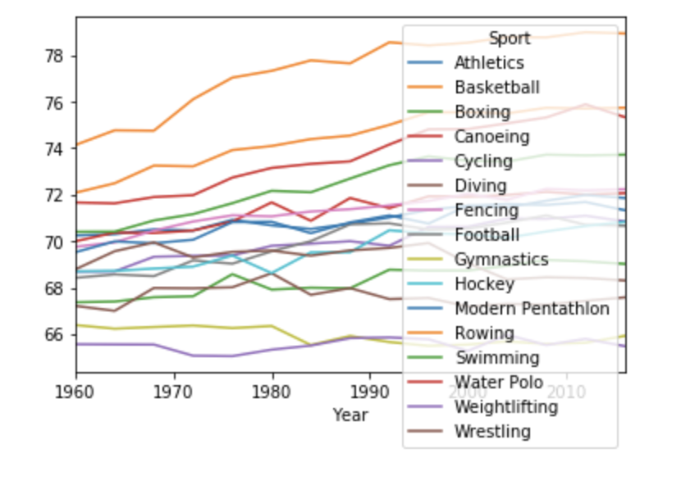

Change in Average Olympian Height Over Time by Sport

Slide 8
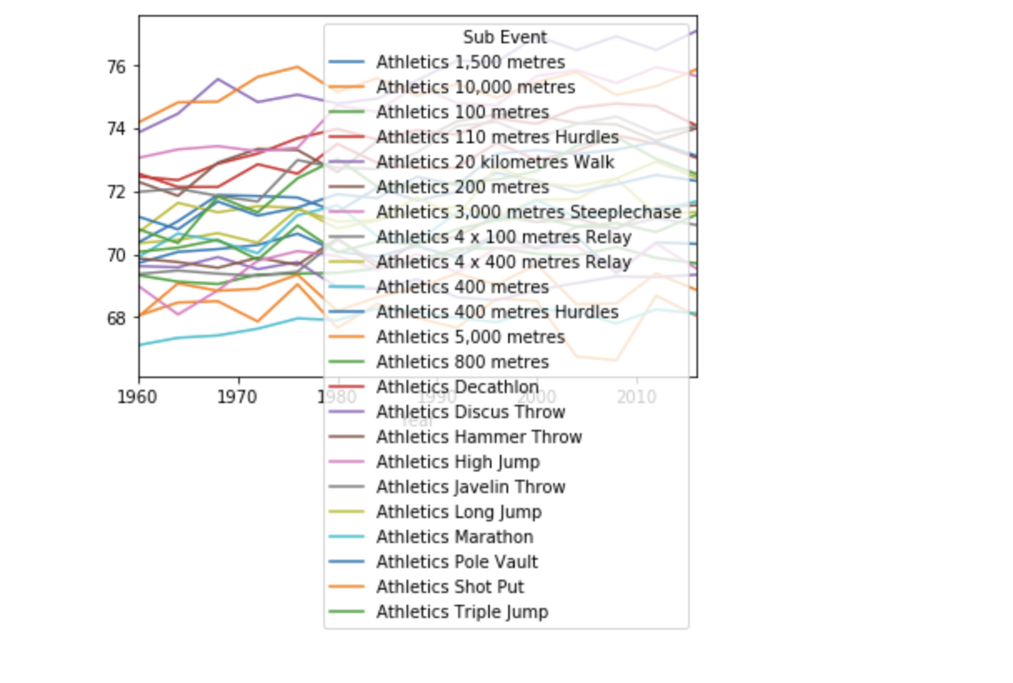

Athletics Track & Field: Changes in Height by Sub Event

Slide 9
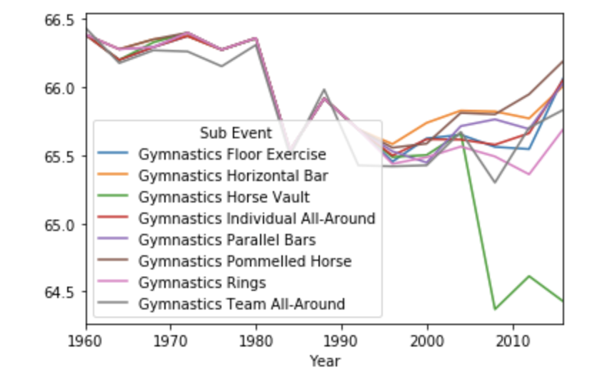

Gymnastics: Changes in Height by Sub Event

Slide 10
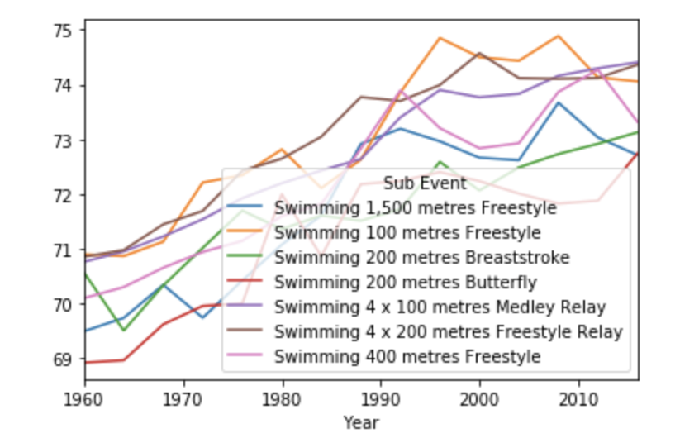

Swimming: Changes in Height by Sub Event

Slide 11

T-Test: Olympians vs Global Average Heights by Sub Event
Sub Event | t Stat | p
Boxing (Lightweight) | -0.666919 | 0.510483
Platform Diving | 0.864365 | 0.395002
T-tests were run to determine whether the difference in average heights between Olympians and the global population was statistically significant for each sub event.
Of the 84 sub events analyzed, only 2 events were found where the average height difference was NOT statistically significant.

Slide 12

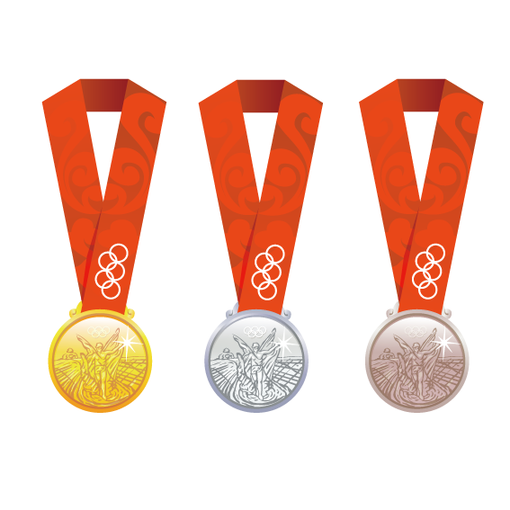
Histogram: Olympic Medalists vs Non-Medalists

Slide 13
T-Test: Olympic Medalists vs Non-Medalists
Sub Event | t Stat | p
Athletics 100 metres | 6.094288 | 0.000001
Athletics 400 metres Hurdles | 5.334984 | 0.000011
Athletics High Jump | 4.382135 | 0.000150
Gymnastics Team All-Around | -4.229536 | 0.000226
Athletics 400 metres | 4.060158 | 0.000358
Gymnastics Individual All-Around | -4.028421 | 0.000389
Swimming 100 metres Freestyle | 3.878010 | 0.000582
Swimming 200 metres Butterfly | 3.867884 | 0.000598
Athletics 200 metres | 3.846759 | 0.000633
Boxing Light-Heavyweight | 3.785355 | 0.000745

Slide 14
Histogram: Athletics 100 metres

Slide 15

Future Work…
Women
Country
Winter Olympics
Predict future heights

Slide 16
Sources

Slide 17

Q&A

